Slide 1


Final Year Project Proposal
Weapon Detection In Surveillance Cameras using AI
Supervised By: Dr. Mansoor Alam (Pofessor)

Slide 2
Project Team
Syed Shakir Hassan(40079)
Muhammad Adeel(40125)

Slide 3
Table of Content
Introduction and Background
Literature Review and Summary Table
Gap Analysis
Problem Statement
Proposed Solution & Methodology
Project Scope
Project Flow
Constraints and Limitation
Work Breakdown Structure
Roles and Responsibilities
References

Slide 4
INTRODUCTION AND BACKGROUND

Slide 5
Introduction & Background [ 1/3]
Background
In Today’s world, the need for security measures is important weather it is the public space, private space or some organization
Traditional systems rely on manual monitoring, which causes delayed response time
They are not designed to automatically detect specific threats such as weapons.
In result they are of high maintenance costs because storing video footages locally can be expensive and difficult to manage

Slide 6
Introduction & Background [ 2/3]
Introduction
Developing an AI Based Weapon Detection System in surveillance cameras to automatically detect weapons in real time video streams
All the stream will be shown Live on the Mobile App
Our System uses deep learning models to analyze footage and trigger an alert when weapon is detected
App will display status of camera and send instant notifications to the concerned personnel

Slide 7
Introduction & Background [ 3/3]
Current Scenario
Airport Security Scanners: Airport Security Systems use advanced imaging technologies such as X ray scanners to detect weapons
Metal Detectors: Metal detectors are commonly used in various settings, including airports, government buildings, and event venues, to detect metallic objects such as firearms, knives, and explosives.
Gunshot Detection Systems: Gunshot detection systems use acoustic sensors to detect and locate the source of gunfire in urban areas.

Slide 8
LITERATURE REVIEW

Slide 9
Literature Review Summary Table
Reference No | Paper Title | Models Used | Results | Limitations
[1] | Weapon Detection in Real-Time CCTV Videos Using Deep Learning | VGG-16, YOLOv4 | YOLOv4: F1-Score = 91%, Mean Average Precision (mAP) = 91.73% | Small objects and occlusion issues Limited dataset
[2] | Real Time Weapon Detection using YOLOv8 and Alert Mechanism | YOLOv8 | Mean Average Precision (MAP) = 0.78 | High Computational Resources Fail to handle crowded environment
[3] | Automatic Detection of Guns in Surveillance Videos | YOLOv3, Faster-RCNN, HOG-based models | Accuracy: 93.1% | Lack of varied dataset

Slide 10
Gap Analysis

Slide 11
Gap Analysis
Delayed Response time in traditional systems
Most systems lack easy access to live stream footage and alert notifications on a single platform
They Lack centralized storage for cross referencing of historical incidents
Most systems require significant upfront costs for hardware like servers and storage
These systems often result in false positives or negatives
The systems may get stuck in detection under varied environmental conditions like occlusion, low lightning or crowd

Slide 12
PROBLEM STATEMENT

Slide 13
Problem Statement
The rising incidents of armed violence create disturbing situation. So the need for automated real time weapon detection in surveillance cameras is increasing. The delayed responses and post analysis and lacking integration with the modern communication systems like mobile apps for streaming and live alerts is a major drawback. Some of the security systems use the mechanisms in which there cost for storage is huge.

Slide 14
PROPOSED SOLUTION AND METHODOLOGY

Slide 15
Solution
Using Deep Learning Models Like Yolo (You Only Look Once) or Faster CNN
Training the model on varied dataset
Trigger alerts whenever a weapon is detected
Storing videos on AWS
Auto Archive the older footages

Slide 16
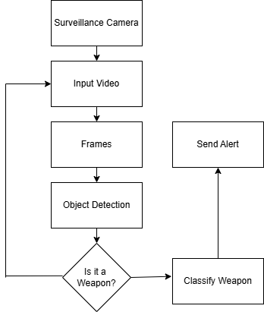
Solution

Slide 17
Methodology [1/2]
The model will process each frame of a video as an image and then process its contents
The model scans the image for the objects of interest. If a weapon is detected the model classifies it and draws a bounding box around it which indicates the exact location of the weapon
The model will assign a confidence score representing surety of weapon
Transferred Learning of the pre trained models
Using the dataset in which the images are taken under the varied environment

Slide 18
Methodology [2/2]
Using AWS Lambda Function to trigger alerts whenever a weapon is detected
Custom algorithms will be used to lower the storage costs and increase the accuracy
Store the footages on S3 buckets for easy availability because it offers easy retrieval of the recorded videos for further analysis
Archiving the older video to lower the cost for storage
A user friendly app where the user can manage multiple streams, see the storage cost

Slide 19
PROJECT SCOPE

Slide 20
Project Scope
Develop a mobile app where user can see the live streams, check the storage cost, and save the feeds
Implement a system that detects weapons in video streams
The model will be designed to work under varied environment
The system will be adaptable to the existing surveillance systems
Send instant notifications when a weapon is detected allowing to respond quickly
Ensure that the system can handle small and large scale deployment
Provide users with both real time video monitoring and archived footage for analysis

Slide 21
Project Flow

Slide 22
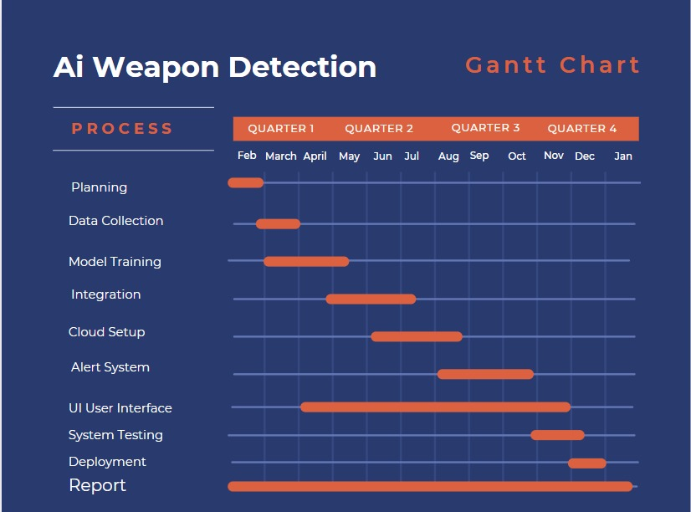

Slide 23
CONSTRAINTS AND LIMITATIONS

Slide 24
Constraints
Resource Intensive:
Requires high computational resources (e.g., GPUs or cloud computing) for real-time processing, and also storage costs which can limit its scalability and increase operational costs.
Time Sensitivity:
Real-time detection requires quick processing speeds. Delays in data transfer or video analysis can compromise system effectiveness.
Data Availability:
Quality datasets for training the system are hard to come by, particularly diverse ones covering various weapon types and real-world scenarios.
System Integration:
Integrating with existing security systems or mobile apps may require significant adjustments or additional development efforts.

Slide 25
Limitations
Detection Errors:
The system may produce false positives (non-weapons detected as weapons) or false negatives (missed weapon detections)
Lack of Context:
The system can detect weapons but cannot assess intent or behavior; it only identifies the presence of weapons.
Concealed Weapons:
Detection may fail for weapons that are hidden or non-metallic, such as those in bags or under clothing.
Environmental Factors:
Poor lighting, obstructions, or low-quality cameras can impact detection accuracy, especially for concealed or partially visible weapons.

Slide 26
Work Break Down Structure

Slide 27
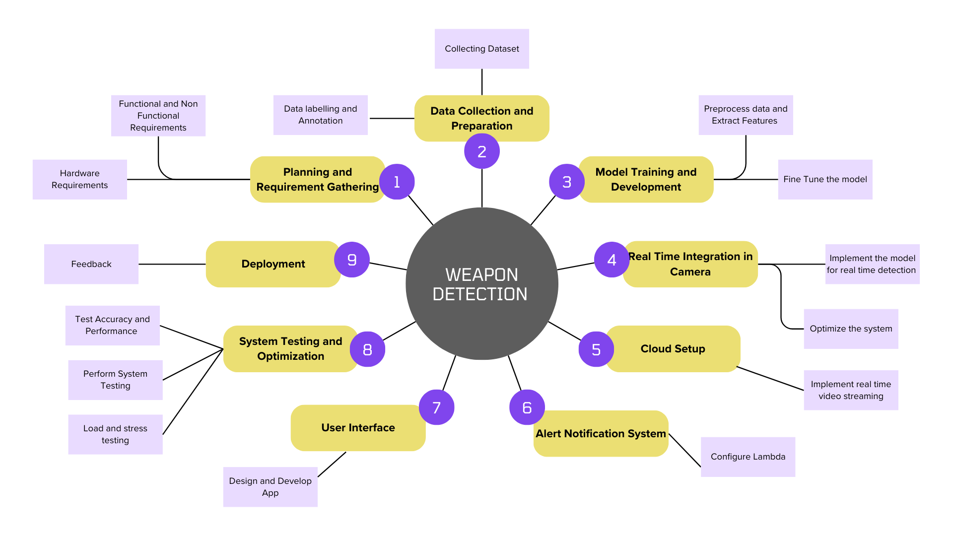
Work Break Down Structure

Slide 28
Roles & Responsibilities

Slide 29
Roles and Responsibilities
Tasks | Shakir | Adeel
Planning and Requirement | ✅ | ✅
Dataset Collection and Preparation | ❌ | ✅
Model Training and Development | ✅ | ✅
Real Time Integration | ✅ | ✅
Cloud Setup | ✅ | ❌
Alert Notification | ❌ | ✅
User Interface | ✅ | ❌
System Testing | ✅ | ✅

Slide 30
References
[1] M. T. Bhatti, M. G. Khan, M. Aslam, and M. J. Fiaz, “Weapon Detection in Real-Time CCTV Videos Using Deep Learning,” IEEE Access, vol. 9, pp. 34366–34382, 2021, doi: 10.1109/ACCESS.2021.3059170.
[2] P. Chunchwar, “Real Time Weapon Detection using YOLOv8 and Alert Mechanism,” Int. J. Res. Appl. Sci. Eng. Technol., vol. 12, no. 4, pp. 2122–2129, Apr. 2024, doi: 10.22214/ijraset.2024.60177.
[3] “WEAPON DETECTION AND ALERT SYSTEM USING YOLO DEEPLEARNING TECHNIQUE TO AVOID CRIMES AND THEFT,” Int. Res. J. Mod. Eng. Technol. Sci., Jun. 2024, doi: 10.56726/IRJMETS59492.

